Slide 1


The Perceptron
Eitan Kosman

Slide 2
agenda
The Problem
Linear Seperability – Def. 1
Linear Seperability – Def. 2
A Biological Neuron
Structure
A Mathematical model
The Solution – Perceptron
A brief history
The algorithm
Intuitive interpretation for weights update
Theorem: Mistake bound
The fall of perceptron
Stopping criterions

Slide 3
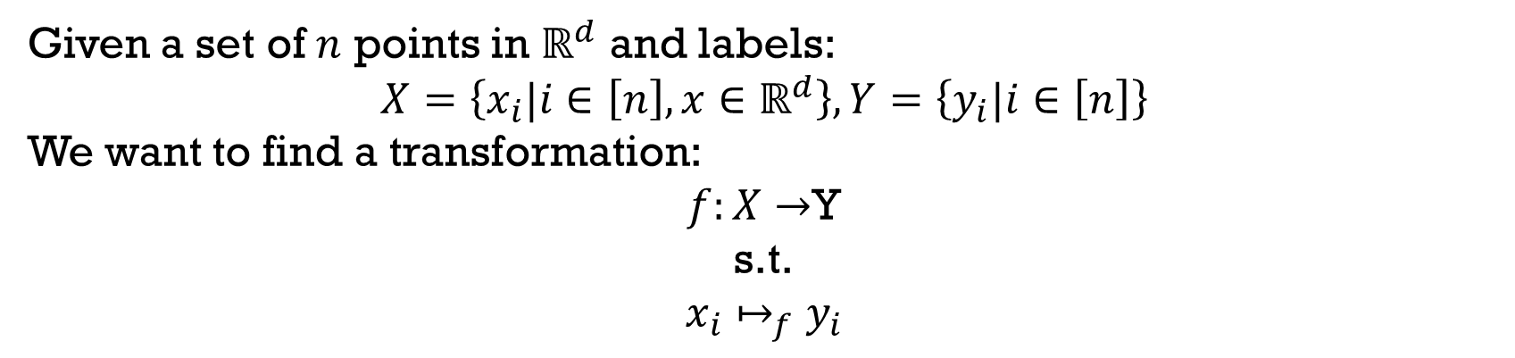
The Problem
Given a set of $n$ points in $ℝ^{d}$ and labels:
$$X=\left\{x_{i}|i∈\left[n\right], x∈ℝ^{d}\right\}, Y=\left\{y_{i}|i∈\left[n\right]\right\}$$
We want to find a transformation:
$f:X→$Y
s.t.
$$x_{i}↦_{f}y_{i}$$

Slide 4
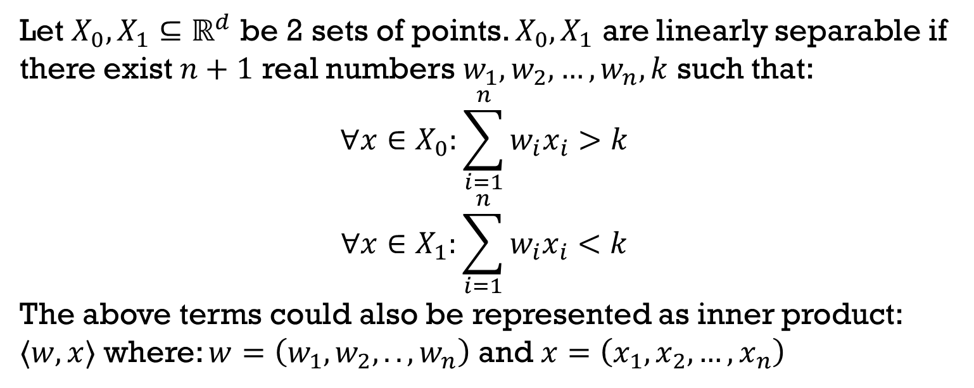
Definition (1): Linear Separability
Let $X_{0}, X_{1}⊆ℝ^{d}$ be 2 sets of points. $X_{0},X_{1}$ are linearly separable if there exist $n+1$ real numbers $w_{1},w_{2},…,w_{n},k$ such that:
$$∀x∈X_{0}:\sum_{i=1}^{n}{w_{i}x_{i}}>k$$
$$∀x∈X_{1}:\sum_{i=1}^{n}{w_{i}x_{i}}<k$$
The above terms could also be represented as inner product: $⟨w,x⟩$ where: $w=\left(w_{1},w_{2},..,w_{n}\right)$ and $x=\left(x_{1},x_{2},…,x_{n}\right)$

Slide 5
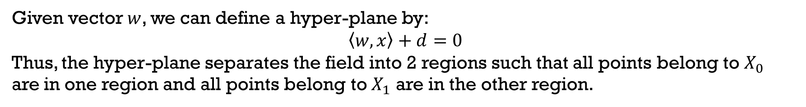
Definition 1 Interpretation
Given vector $w$, we can define a hyper-plane by:
$$\left\langle w,x\right\rangle +d=0$$
Thus, the hyper-plane separates the field into 2 regions such that all points belong to $X_{0}$ are in one region and all points belong to $X_{1}$ are in the other region.

Slide 6
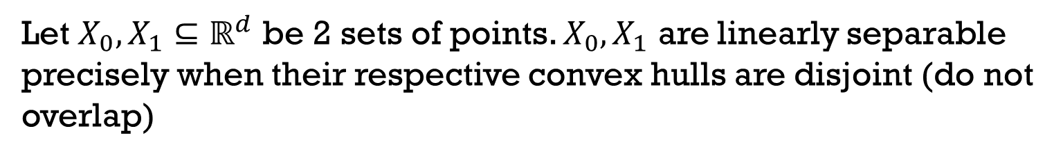
Definition (2): Linear Seperability
Let $X_{0}, X_{1}⊆ℝ^{d}$ be 2 sets of points. $X_{0},X_{1}$ are linearly separable precisely when their respective convex hulls are disjoint (do not overlap)

Slide 7
agenda
The Problem
Linear Seperability – Def. 1
Linear Seperability – Def. 2
The Biological Neuron
Structure
A Mathematical model
The Solution – Perceptron
A brief history
The algorithm
Intuitive interpretation for weights update
Theorem: Mistake bound
The fall of perceptron
Stopping criterions

Slide 8
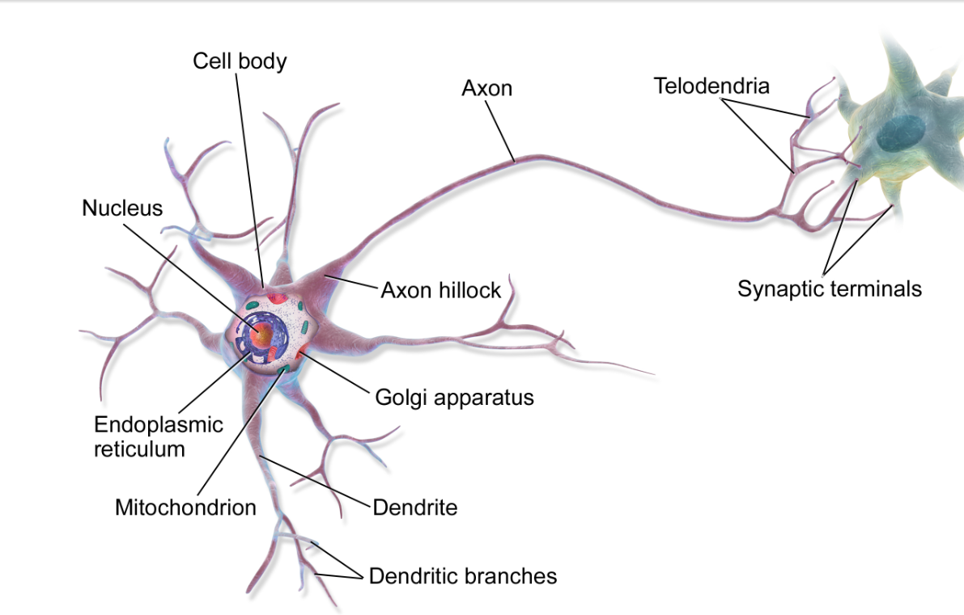
The biological neuron - Structure
Like any other body cell, the neuron has a cell body which contains a nucleus where the DNA is stored.
From our perspective, the interesting parts are:
Dendrites – make connections with tens of thousand of other cells; other neurons. The behave as “inputs”.
Axon – transmits information to different neurons, muscles, and other body cells based on the signals the cell receives. It’s signals are received by other cells’ dendrites.

Slide 9
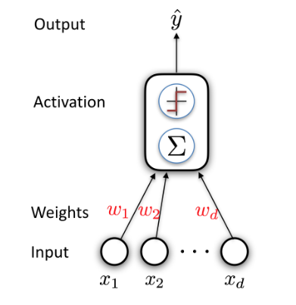


The biological neuron – a mathematical model
We will try to mimic the function of a neuron using mathematical tools. Given an input vector $x:$
$x$ will be the inputs of the neuron (dendrites).
Define a weight, $w_{i}$, for each input, and sum all the multiplications.
Output the result as $\hat{y}$ (Axon)
There’s still a problem – How do we find the weights?

Slide 10
agenda
The Problem
Linear Seperability – Def. 1
Linear Seperability – Def. 2
The Biological Neuron
Structure
A Mathematical model
The Solution – Perceptron
A brief history
The algorithm
Intuitive interpretation for weights update
Theorem: Mistake bound
The fall of perceptron
Stopping criterions

Slide 11
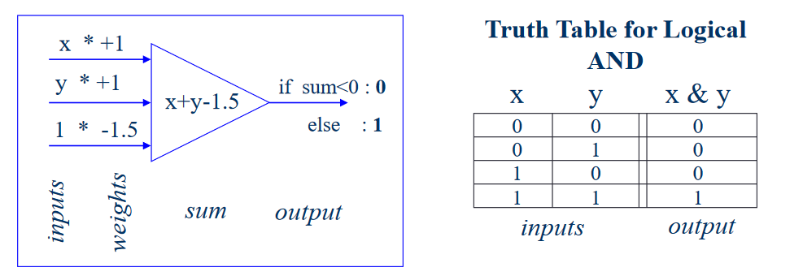
prehistory
Because of the “all-or-none” character of nervous activity, neural events and the relations among them can be treated by means of propositional logic.
W.S. McCulloch & W. Pitts (1943). “A logical calculus of the ideas immanent in nervous activity”, Bulletin of Mathematical Biophysics, 5, 115-137
This seminal paper pointed out that simple artificial “neurons” could be made to perform basic logical operations such as AND, OR and NOT

Slide 12
Truth Table for Logical OR
x * +1
y * +1
if sum<0 : 0
else : 1
x
y
x | y
x+y-1
1 * -1
0
0
0
0
1
1
1
0
1
inputs
sum
output
1
1
1
weights
inputs
output

Slide 13
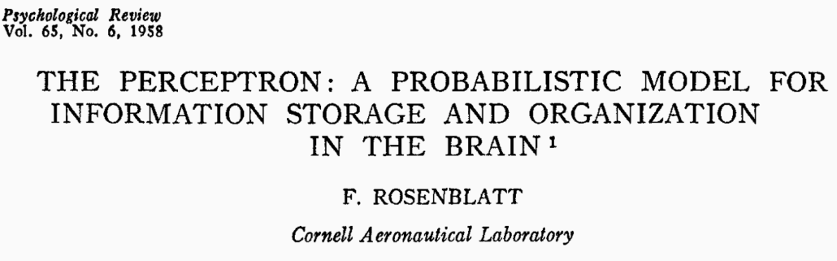
1958 – the perceptron

Slide 14


Slide 15

Perceptron – The algorithm
The goal is to find a hyper-plane separating 2 known classes.
Consider definition (1) for linear separability:
$∀x∈X_{0}:\left\langle w,x\right\rangle >k$
$∀x∈X_{1}:\left\langle w,x\right\rangle <k$
$$⇓$$
$∀x∈X_{0}:\left\langle w,x\right\rangle −k>0$
$∀x∈X_{1}:\left\langle w,x\right\rangle −k<0$

Slide 16


We can eliminate $k$ by augmenting representation with one dimension:
$$x^{′}=\left(x,1\right)$$
$$w^{′}=\left(w, −k\right)$$
$$\left\langle w^{′},x^{′}\right\rangle =\left(w,−k\right)\left(\begin{aligned}x \\ 1\end{aligned}\right)=w⋅x−k$$

Slide 17
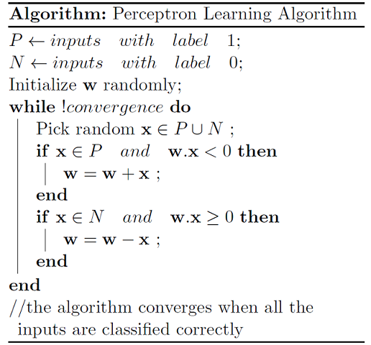

Slide 18
Weights Update : Intuition
The orange points are from class -1 and the green points are from class +1.
How would we update the decision line so that it classifies all the points correctly?

Slide 19

$$\left\langle w,x_{i}\right\rangle >0$$
$$y_{i}=−1$$
+1
-1

Slide 20
$$\left\langle w,x_{i}\right\rangle >0$$
$$y_{i}=−1$$
+1
-1

Slide 21
$$\left\langle w,x_{i}\right\rangle >0$$
$$y_{i}=−1$$
+1
-1

Slide 22
$$\left\langle w,x_{i}\right\rangle >0$$
$$y_{i}=−1$$
+1
-1

Slide 23
$$\left\langle w,x_{i}\right\rangle >0$$
$$y_{i}=−1$$
+1
-1

Slide 24
-1
$$\left\langle w,x_{i}\right\rangle >0$$
$$y_{i}=−1$$
+1

Slide 25
-1
+1

Slide 26
-1
+1

Slide 27
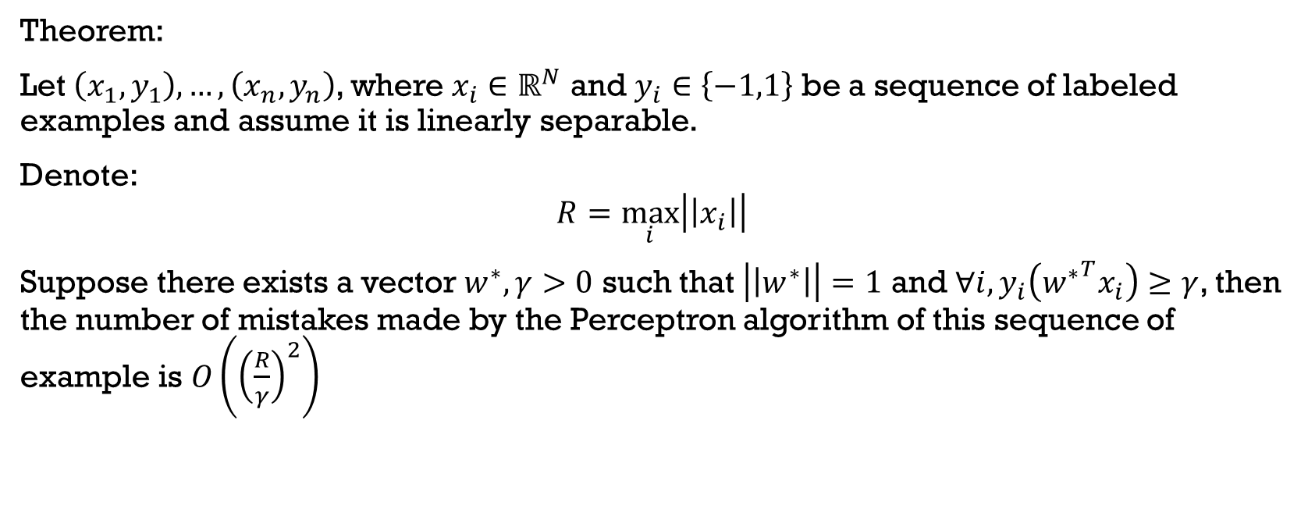
mistake bound
Theorem:
Let $\left(x_{1},y_{1}\right),…,\left(x_{n},y_{n}\right)$, where $x_{i}∈ℝ^{N}$ and $y_{i}∈\left\{−1,1\right\}$ be a sequence of labeled examples and assume it is linearly separable.
Denote:
$$R=\max_{i}\left|\left|x_{i}\right|\right|$$
Suppose there exists a vector $w^{∗}, γ>0$ such that $\left|\left|w^{∗}\right|\right|=1$ and $∀i, y_{i}\left({w^{∗}}^{T}x_{i}\right)≥γ$, then the number of mistakes made by the Perceptron algorithm of this sequence of example is $O\left({\left(\frac{R}{γ}\right)}^{2}\right)$

Slide 28




$$R=\max_{i}\left|\left|x_{i}\right|\right|$$
$$∀i, y_{i}\left({w^{∗}}^{T}x_{i}\right)≥γ$$
$$γ$$
$$R$$

Slide 29

mistake bound
Let $w_{1}=0$ (initial weight vector) and denote $w_{k}$ the weight vector after the $k^{′}th$ mistake.
Lemma 1: $w_{t+1}⋅w^{∗}≥w_{t}⋅w^{∗}+γ$
Lemma 2: ${\left|\left|w_{t+1}\right|\right|}^{2}≤{\left|\left|w_{t}\right|\right|}^{2}+R^{2}$

Slide 30
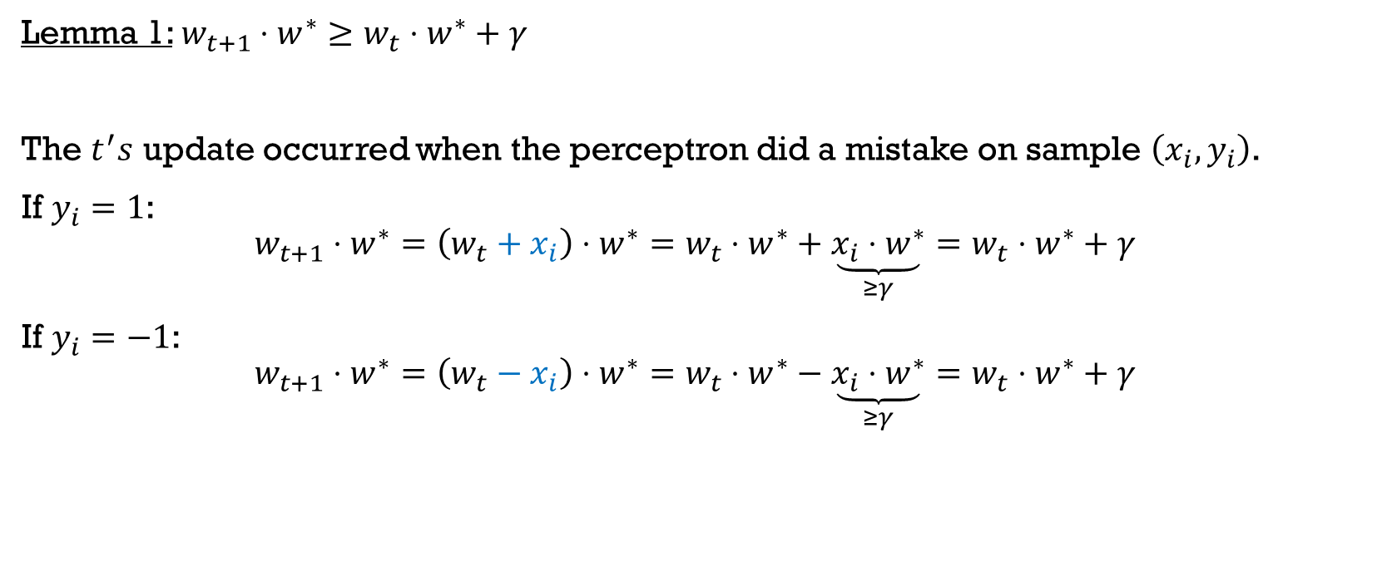
mistake bound
Lemma 1: $w_{t+1}⋅w^{∗}≥w_{t}⋅w^{∗}+γ$
The $t^{′}s$ update occurred when the perceptron did a mistake on sample $\left(x_{i},y_{i}\right)$.
If $y_{i}=1$:
$$w_{t+1}⋅w^{∗}=\left(w_{t}+x_{i}\right)⋅w^{∗}=w_{t}⋅w^{∗}+\underset{≥γ}{\underbrace{x_{i}⋅w^{∗}}}=w_{t}⋅w^{∗}+γ$$
If $y_{i}=−1$:
$$w_{t+1}⋅w^{∗}=\left(w_{t}−x_{i}\right)⋅w^{∗}=w_{t}⋅w^{∗}−\underset{≥γ}{\underbrace{x_{i}⋅w^{∗}}}=w_{t}⋅w^{∗}+γ$$

Slide 31
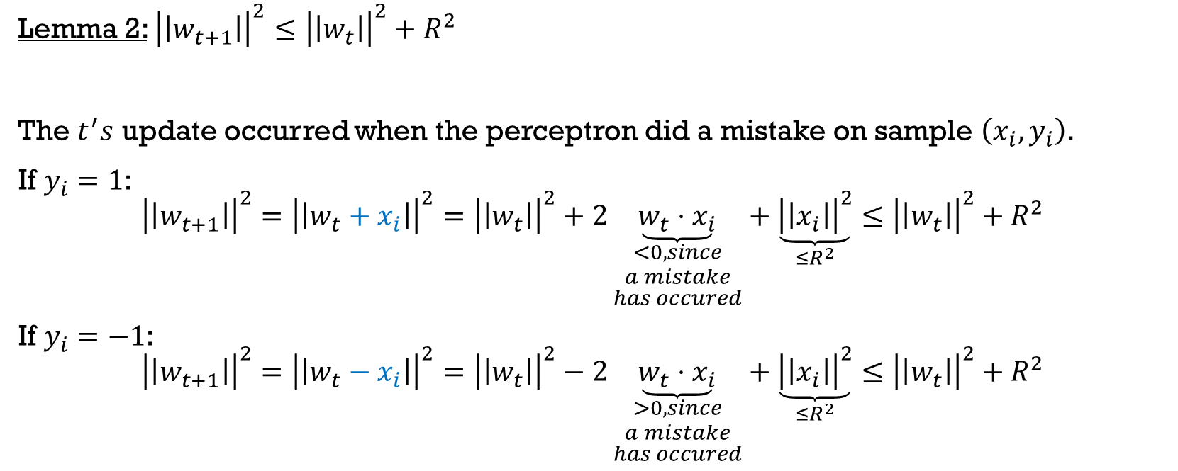
mistake bound
Lemma 2: ${\left|\left|w_{t+1}\right|\right|}^{2}≤{\left|\left|w_{t}\right|\right|}^{2}+R^{2}$
The $t^{′}s$ update occurred when the perceptron did a mistake on sample $\left(x_{i},y_{i}\right)$.
If $y_{i}=1$:
$${\left|\left|w_{t+1}\right|\right|}^{2}={\left|\left|w_{t}+x_{i}\right|\right|}^{2}={\left|\left|w_{t}\right|\right|}^{2}+2\underset{\begin{aligned}<0, since \\ a mistake \\ has occured\end{aligned}}{\underbrace{w_{t}⋅x_{i}}}+\underset{≤R^{2}}{\underbrace{{\left|\left|x_{i}\right|\right|}^{2}}}≤{\left|\left|w_{t}\right|\right|}^{2}+R^{2}$$
If $y_{i}=−1$:
$${\left|\left|w_{t+1}\right|\right|}^{2}={\left|\left|w_{t}−x_{i}\right|\right|}^{2}={\left|\left|w_{t}\right|\right|}^{2}−2\underset{\begin{aligned}>0, since \\ a mistake \\ has occured\end{aligned}}{\underbrace{w_{t}⋅x_{i}}}+\underset{≤R^{2}}{\underbrace{{\left|\left|x_{i}\right|\right|}^{2}}}≤{\left|\left|w_{t}\right|\right|}^{2}+R^{2}$$

Slide 32
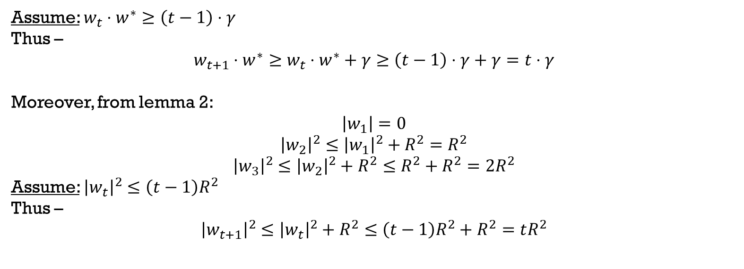
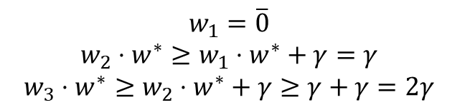
mistake bound
Now, equipped with the two lemmas, we know that from Lemma 1:
$$w_{1}=\overline{0}$$
$$w_{2}⋅w^{∗}≥w_{1}⋅w^{∗}+γ=γ$$
$$w_{3}⋅w^{∗}≥w_{2}⋅w^{∗}+γ≥γ+γ=2γ$$
Assume: $w_{t}⋅w^{∗}≥\left(t−1\right)⋅γ$
Thus –
$$w_{t+1}⋅w^{∗}≥w_{t}⋅w^{∗}+γ≥\left(t−1\right)⋅γ+γ=t⋅γ$$
Moreover, from lemma 2:
$$\left|w_{1}\right|=0$$
$${\left|w_{2}\right|}^{2}≤{\left|w_{1}\right|}^{2}+R^{2}=R^{2}$$
$${\left|w_{3}\right|}^{2}≤{\left|w_{2}\right|}^{2}+R^{2}≤R^{2}+R^{2}=2R^{2}$$
Assume: ${\left|w_{t}\right|}^{2}≤\left(t−1\right)R^{2}$
Thus –
$${\left|w_{t+1}\right|}^{2}≤{\left|w_{t}\right|}^{2}+R^{2}≤\left(t−1\right)R^{2}+R^{2}=tR^{2}$$

Slide 33

mistake bound
Recap:
After $T$ mistakes:
$$w_{T+1}⋅w^{∗}≥T⋅γ$$
$${\left|w_{T+1}\right|}^{2}≤TR^{2}$$
$$⇓$$
$$γT≤\underset{scalar}{\underbrace{w_{T+1}⋅w^{∗}}}=\left|w_{T+1}⋅w^{∗}\right|\underset{\begin{aligned}Cauchy \\ Schwarz\end{aligned}}{\underbrace{≤}}\left|w_{T+1}\right|⋅\underset{=1}{\underbrace{\left|w^{∗}\right|}}=\left|w_{T+1}\right|$$
$$⇓$$
$$γ^{2}T^{2}≤{\left|w_{T+1}\right|}^{2}≤TR^{2}$$
$$⇓$$
$$T≤\frac{R^{2}}{γ^{2}}$$

Slide 34
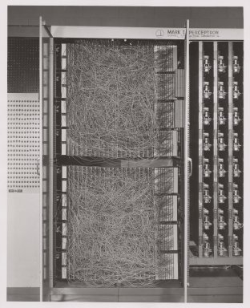
The fall of the perceptron
The first computer built around the concept of perceptron looked like this.
Even the wiring was supposed to simulate the connections of neurons.

Slide 35

The fall of the perceptron
However, a paper describing the perceptron’s shortcomings, particularly that it was effective only at solving simple problems, led to a drastic drop in interest in artificial neural networks in the 1960’s.
Unless input categories were “linearly separable”, a perceptron could not learn to discriminate between them. Example:

Slide 36
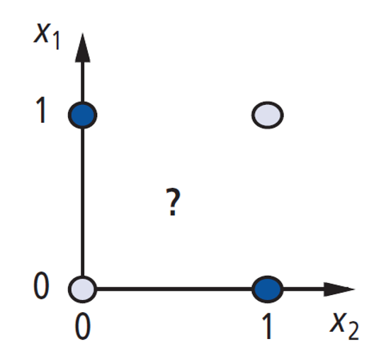
xor

Slide 37
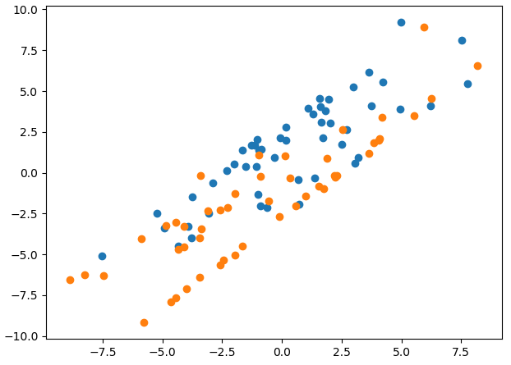
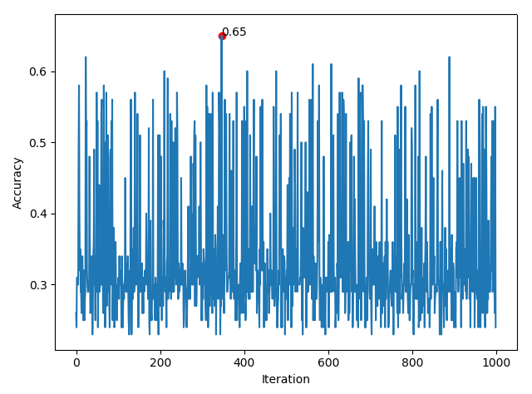
Stopping criterions
The mistake bound holds only if the dataset is linearly separable.
If it’s not the case, one could define other critertions:
Approach 1: Consider the perceptron as an any-time algorithm. When the user is out of time or resources, return the current weights.
Approach 2: After each update, calculate the accuracy, and remember the weights with highest accuracy:

